Slide 1

E-Commerce Shopping Website
AJT Project
by
Dhairya Aundhia-92200103268
Rishi Patel - 92200103288
[3TC4]

Slide 2
Contents
Introduction to Project
Technologies Used
Project Operations
Existing System
Proposed System
Working
Screenshots
Conclusion

Slide 3
Website Introduction
ShopiGo is your ultimate destination for all things fashion. Our online shopping website is dedicated to clothing, where you can explore a wide range of trendy and stylish outfits.
Whether you're looking for the perfect dress, comfortable casual wear, or the latest in fashion trends, ShopiGo has got you covered.
Discover a world of fashion at your fingertips and shop with ease at ShopiGo!

Slide 4
Technology Used
Frontend
HTML
CSS
Bootstrap
Backend
JDBC
Servlet
JSP

Slide 5
Project Operations
SignUp
Login
Cart
Add Items
Remove Items
Amount Calculation
Forgot Password
Update User Information
Delete User Permanently

Slide 6
Existing System
Create Account
Login
Forgot Password
Update Profile
Cart

Slide 7
Proposed System
Additional Features
Easy And User Freindly.
For all devices and platform (full responsive).
Easy to add and remove items from cart.
Allows user to permanently delete their account.

Slide 8
Working
Users can easily Signup and then Login to our website.
After Login, Users can add or remove items in cart according to their choice.
Then users can easily update their information.
Now if User has forgotten their password then they can easily reset the password using the security which they has set during SignUp.
Also User can Delete his/her account permanently.

Slide 9
Screenshots with Example

Slide 10
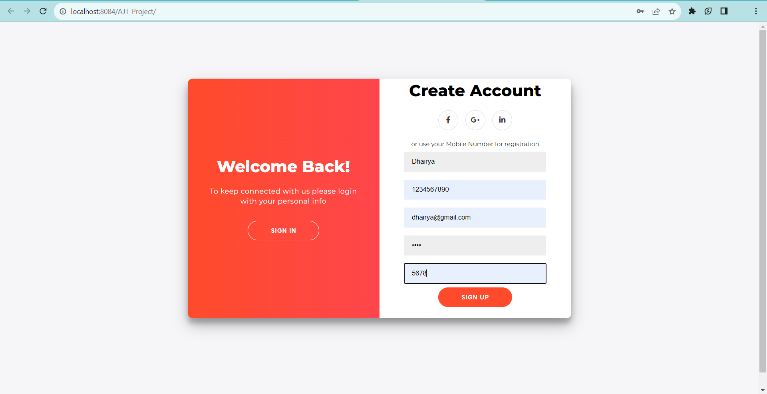
This is First page of wesite First we will create account.

Slide 11
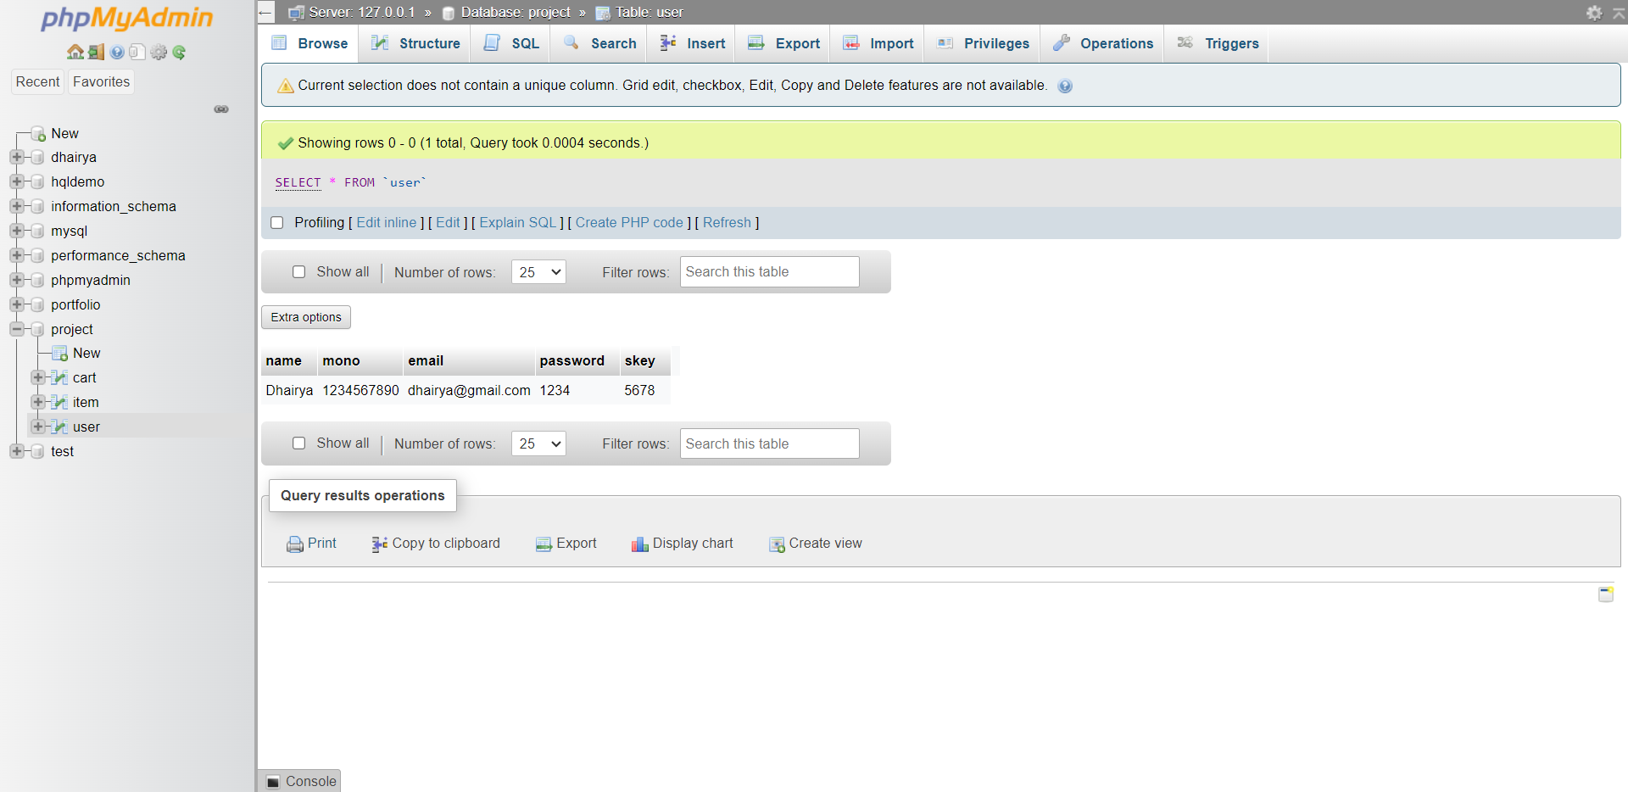
User has Successfully SignedUp

Slide 12
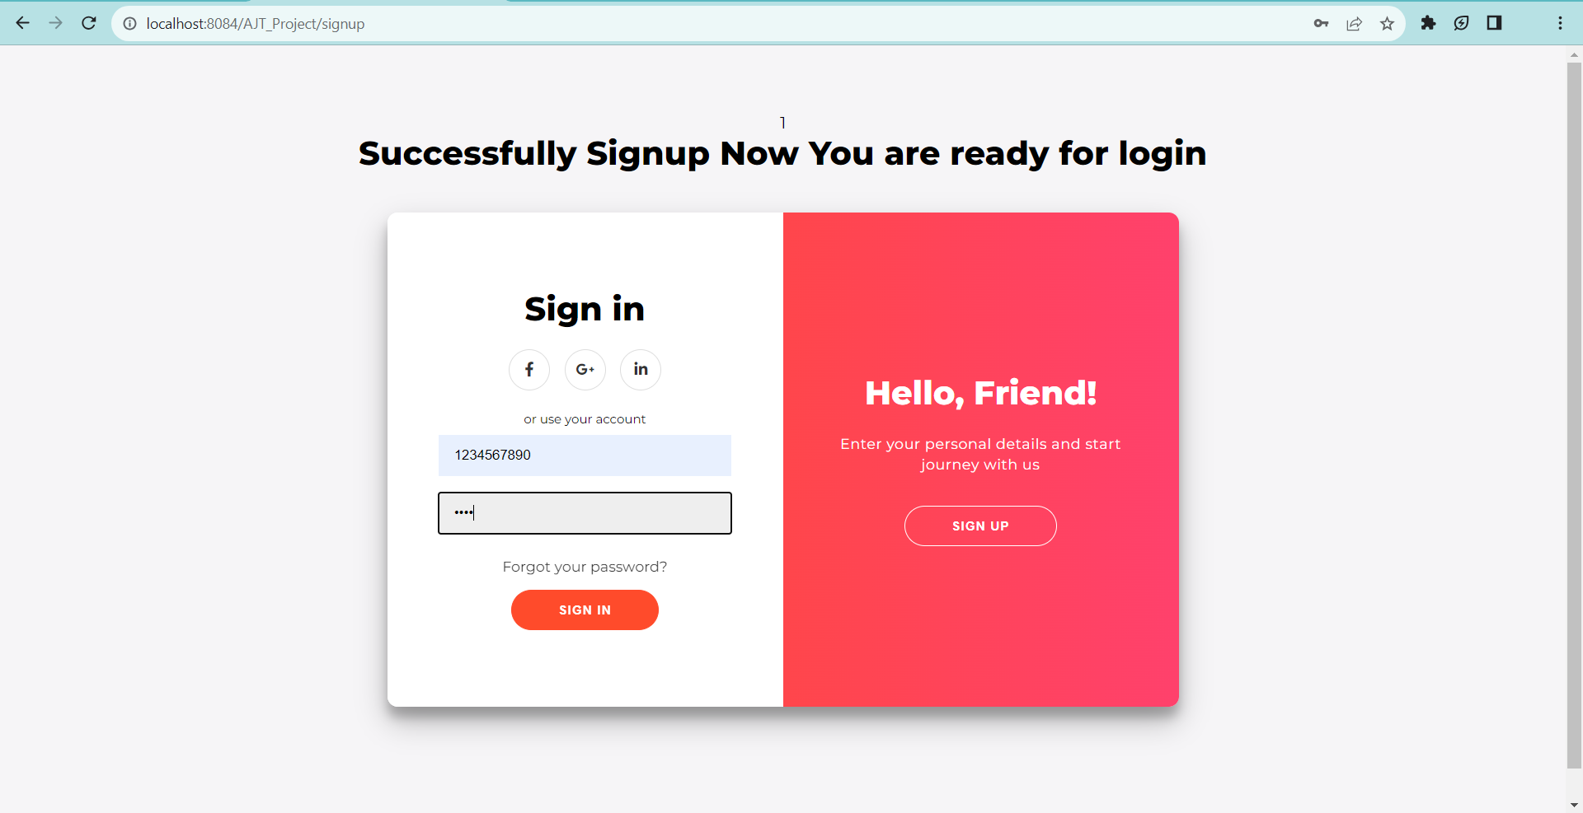
Now We will move forward for Login

Slide 13
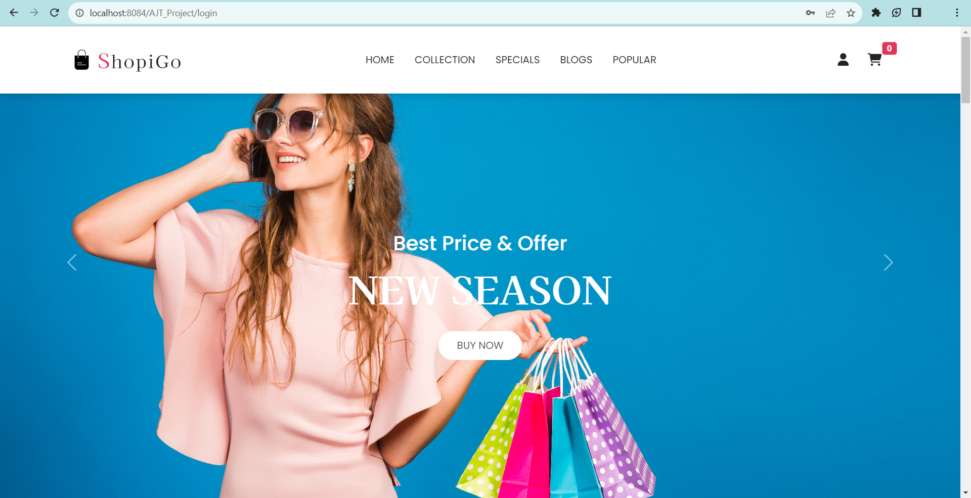
After Login user will redirect to Home Page of website

Slide 14
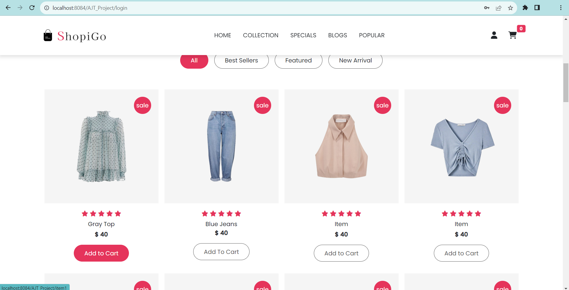
Right Now we can see cart is empty now we will add some items in cart

Slide 15
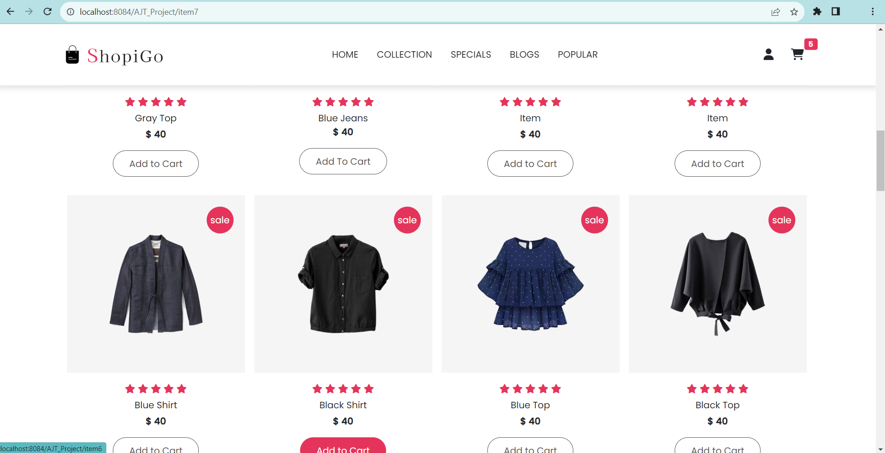
After adding 5 items we can see cart number is increased

Slide 16
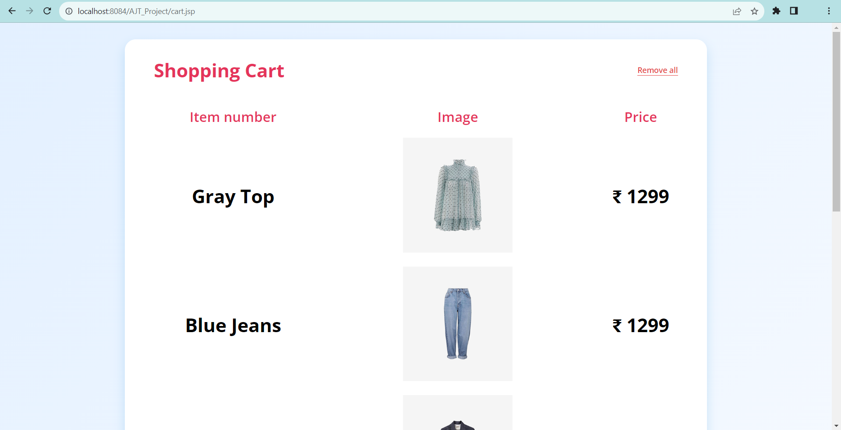
Now we will explore cart

Slide 17
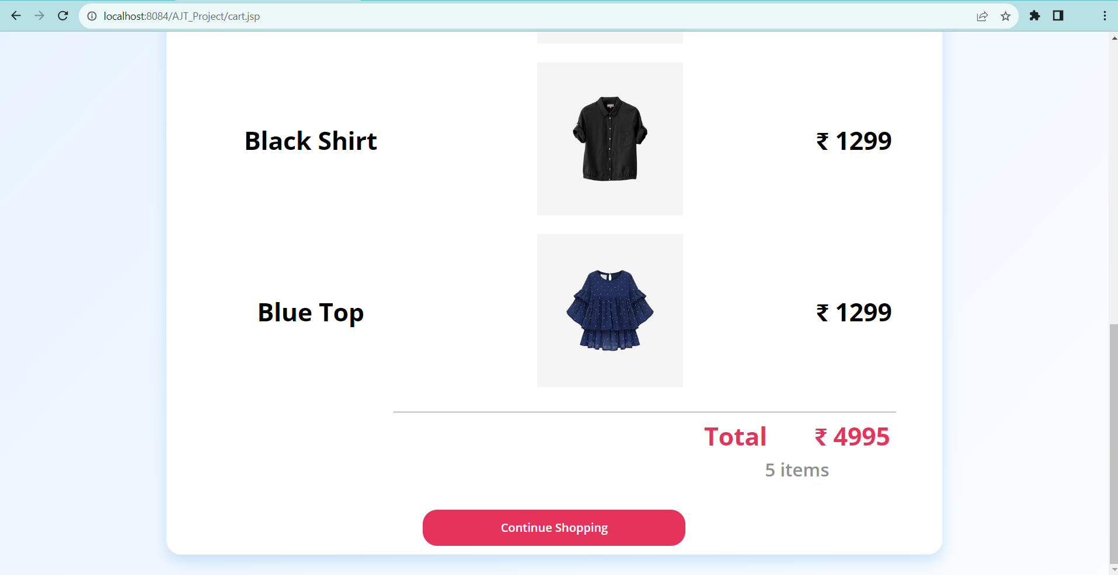
Now here we can see total number of products and total amount

Slide 18
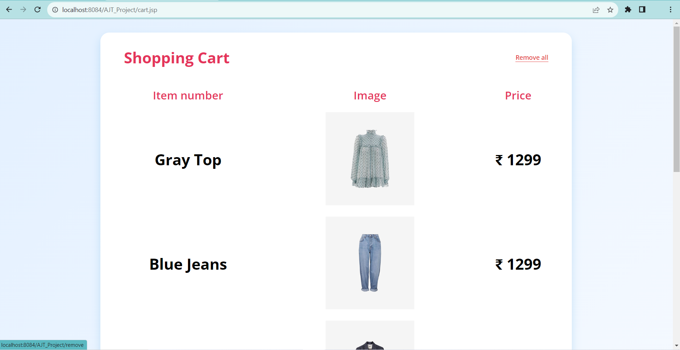
Now we will remove all items from cart by Remove all button

Slide 19
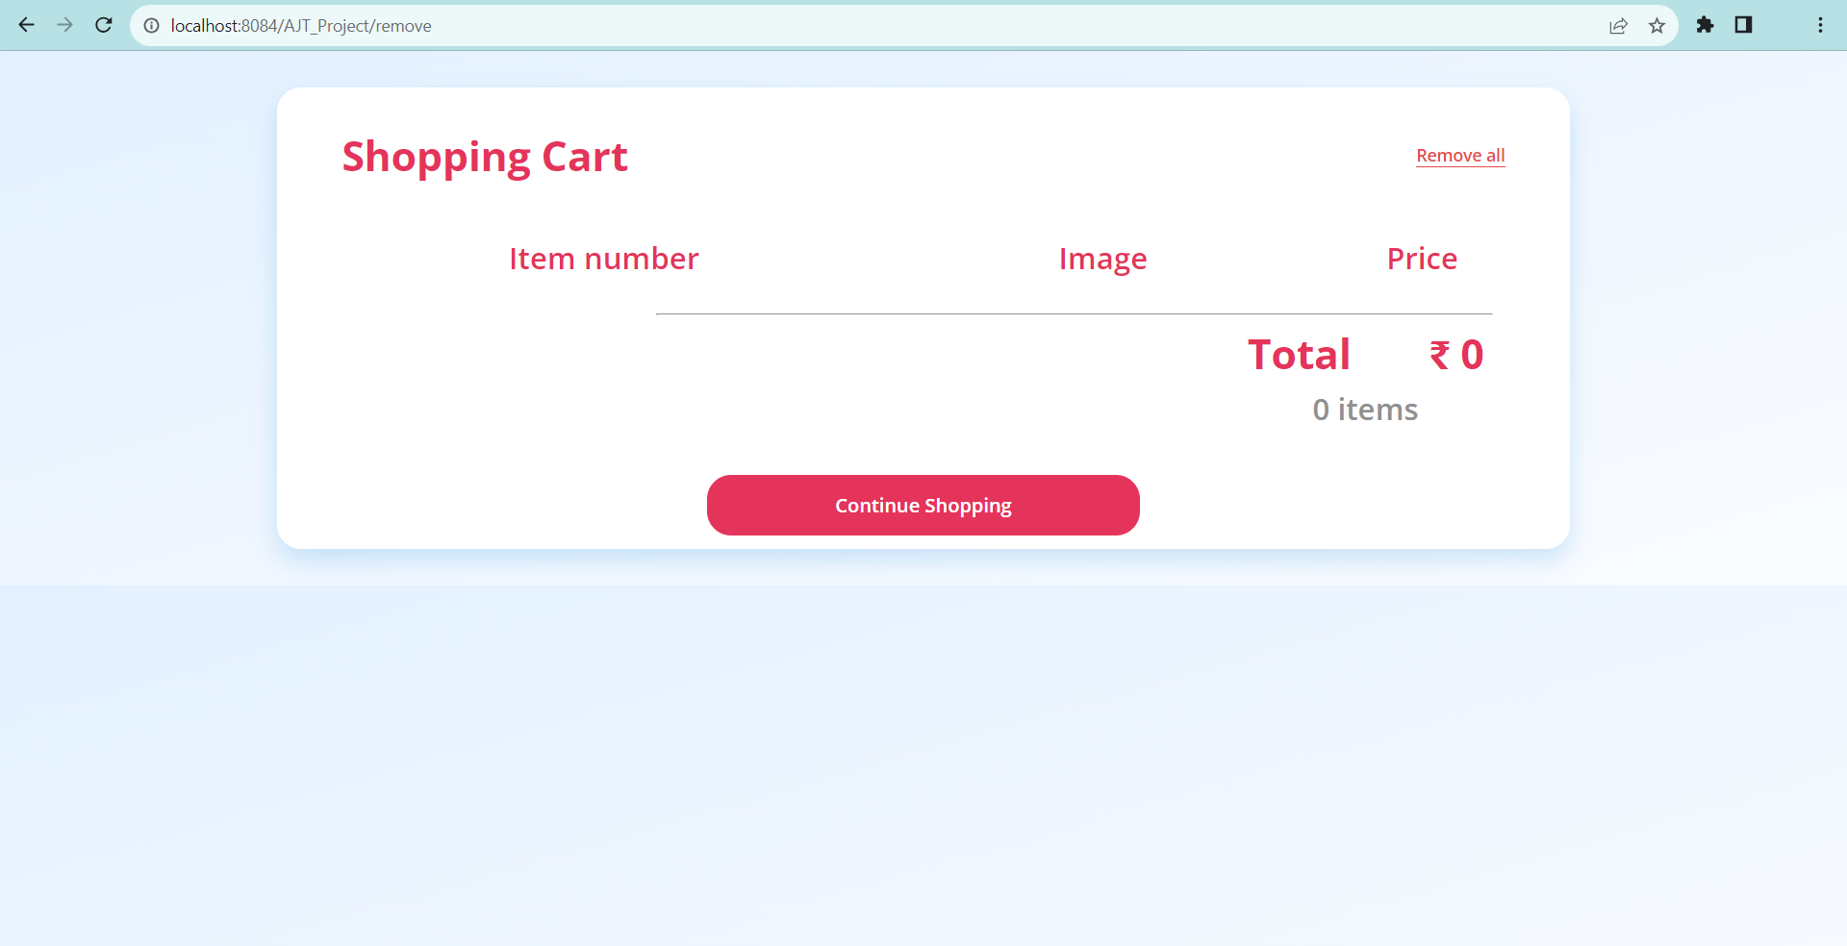
Now we can see cart is empty Now we will click on continue shopping to go to home page

Slide 20
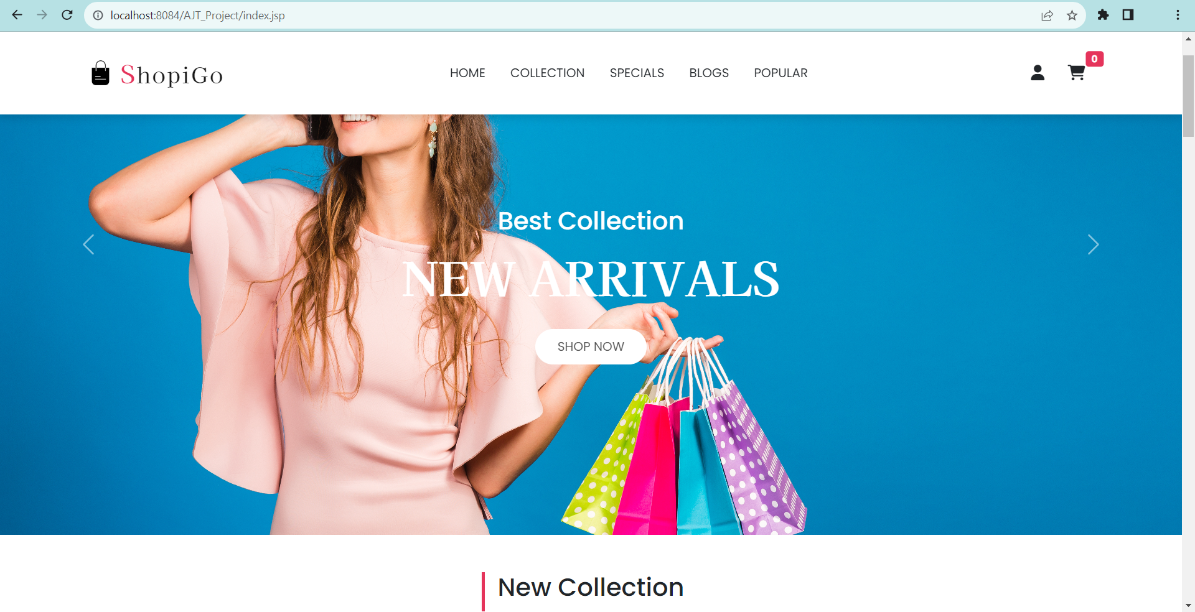
Now we will go to profile section by clicking user icon

Slide 21
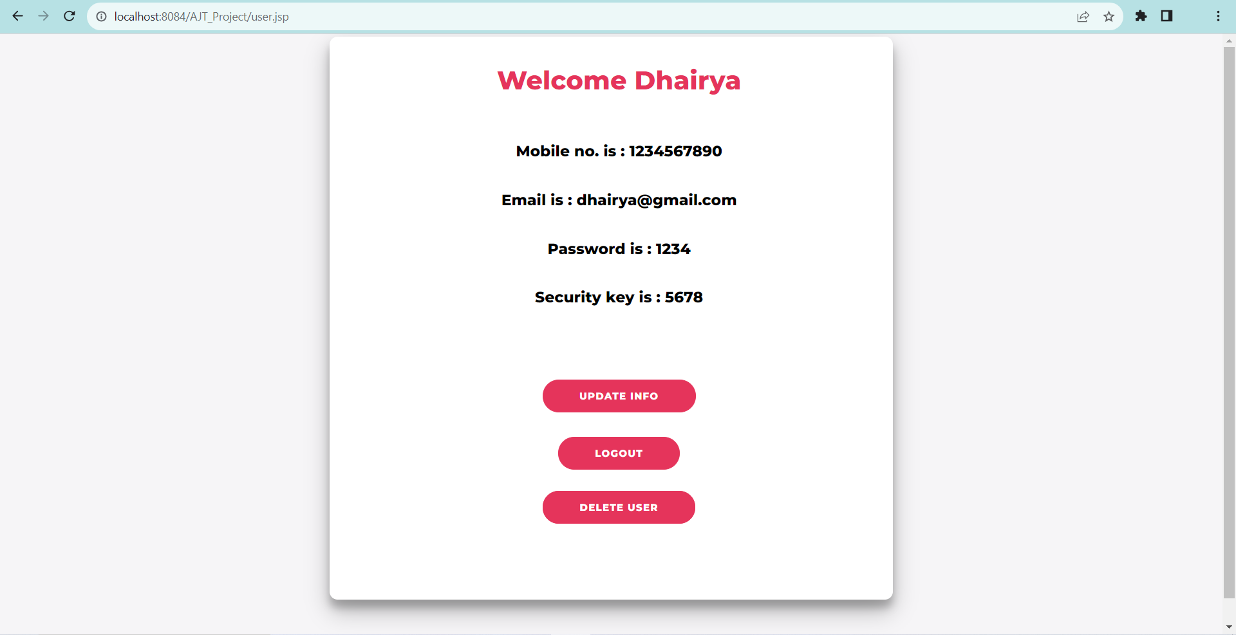
Now here User can see their information.

Slide 22
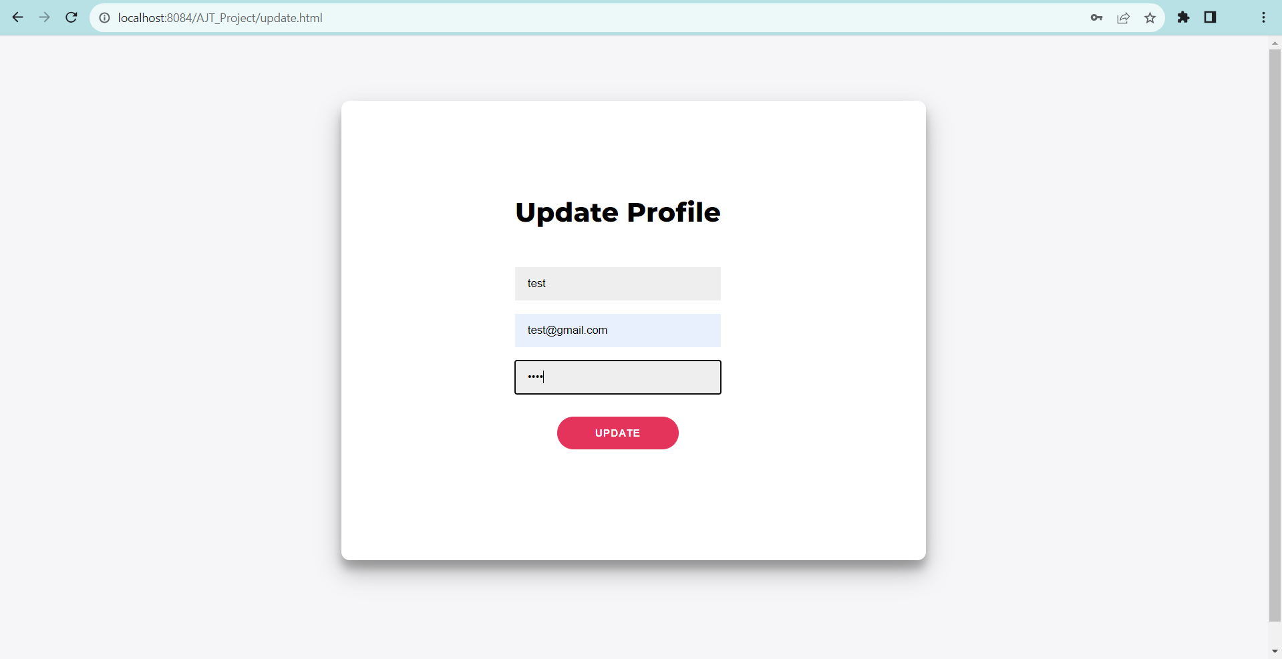
Now we will Update User Information by clicking Update Info Button

Slide 23
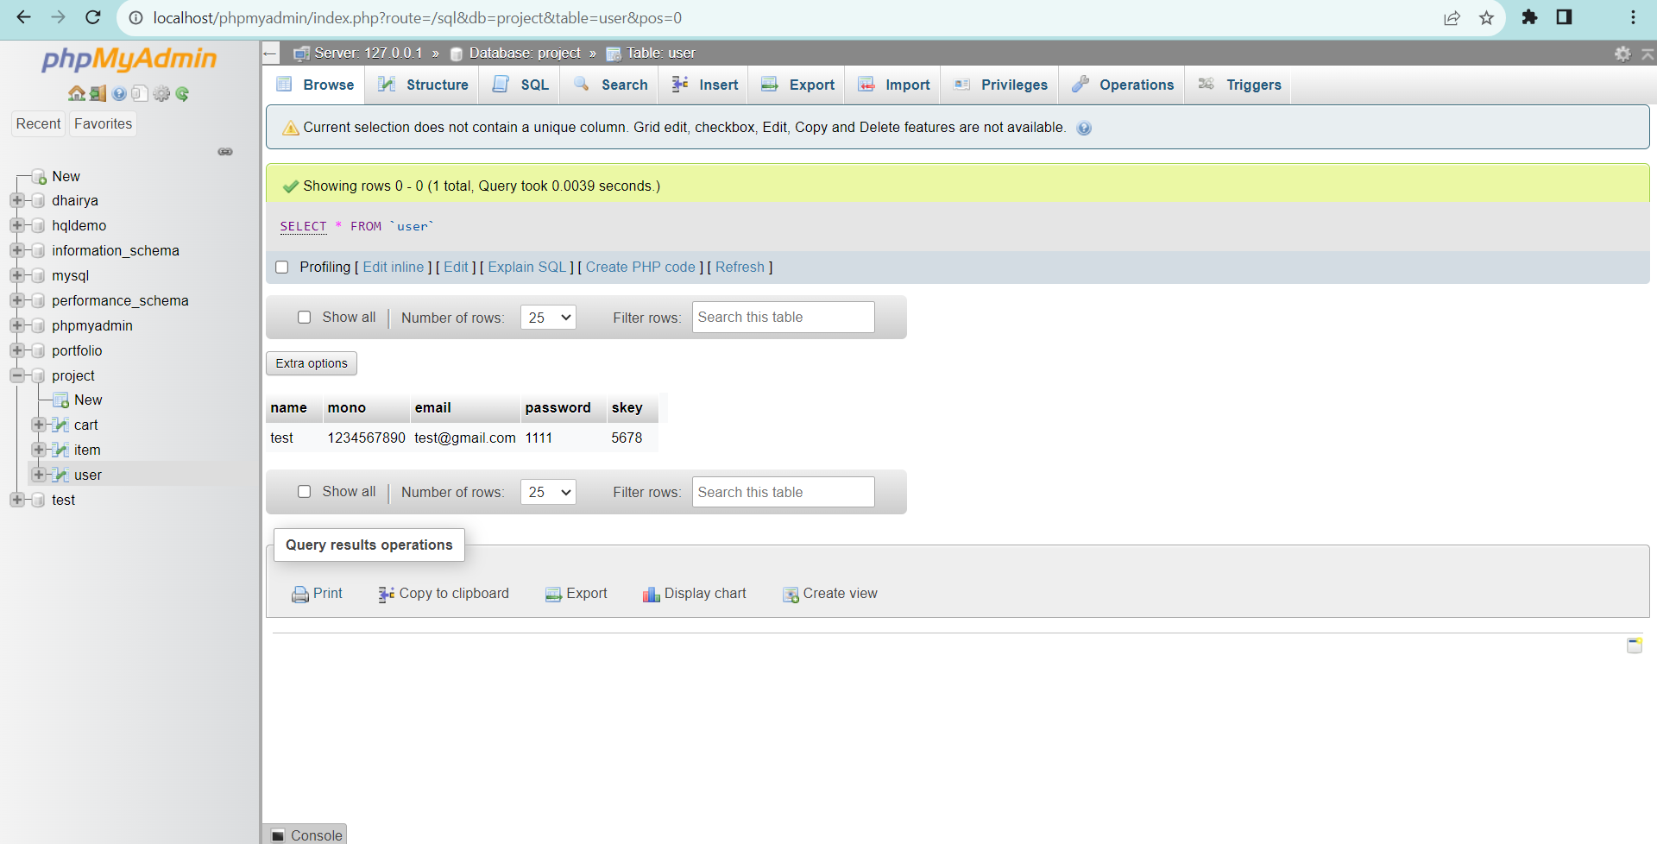
Now we can see our profile is updated

Slide 24
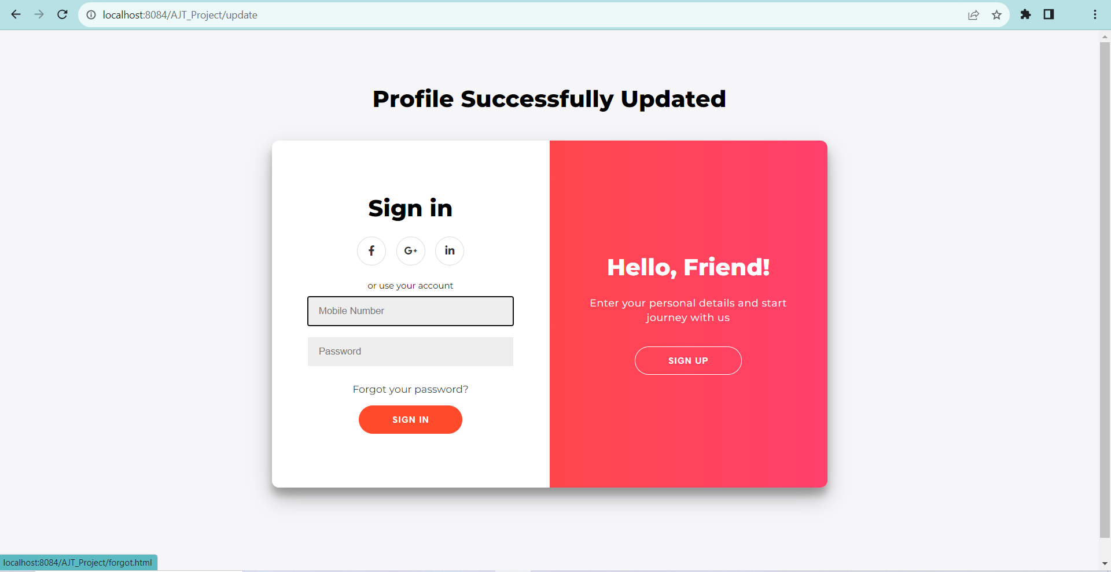
Now we will use forgot password feature

Slide 25
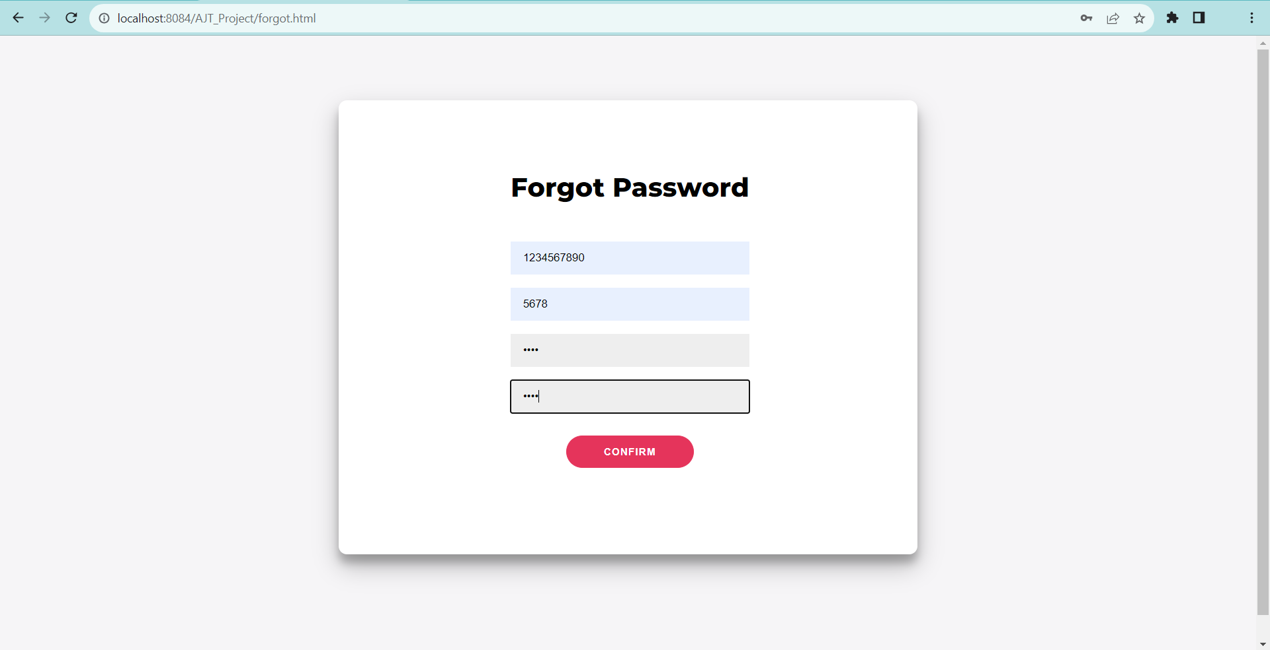
Now we will reset the password

Slide 26
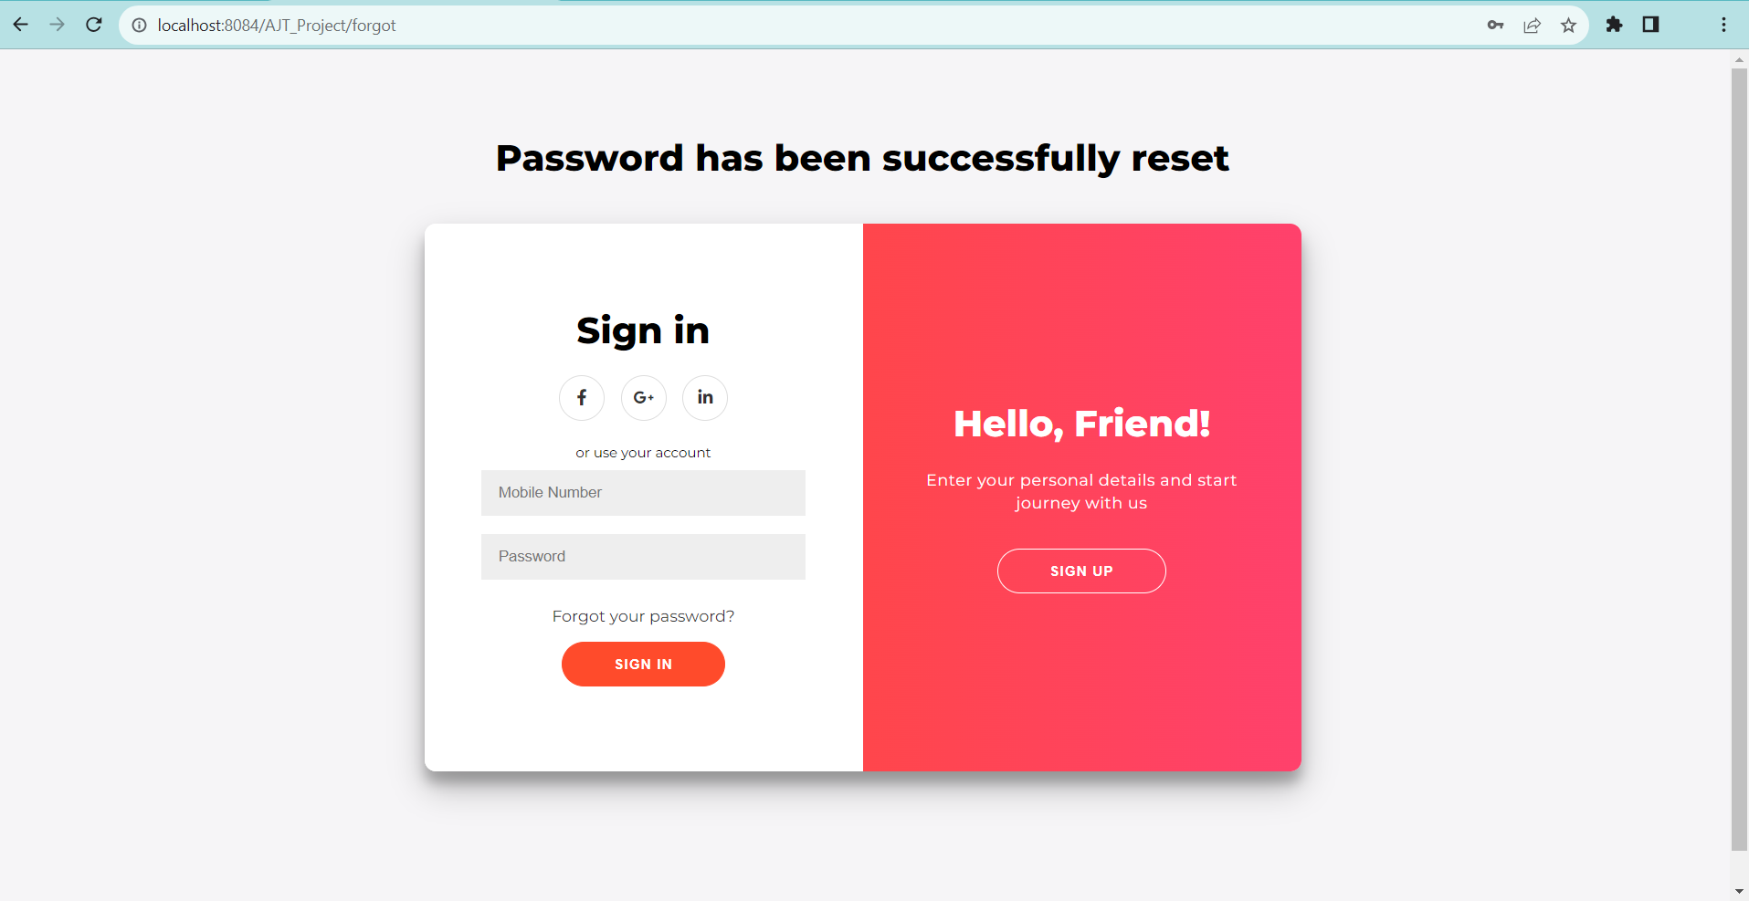
Now password has been successfully reset

Slide 27
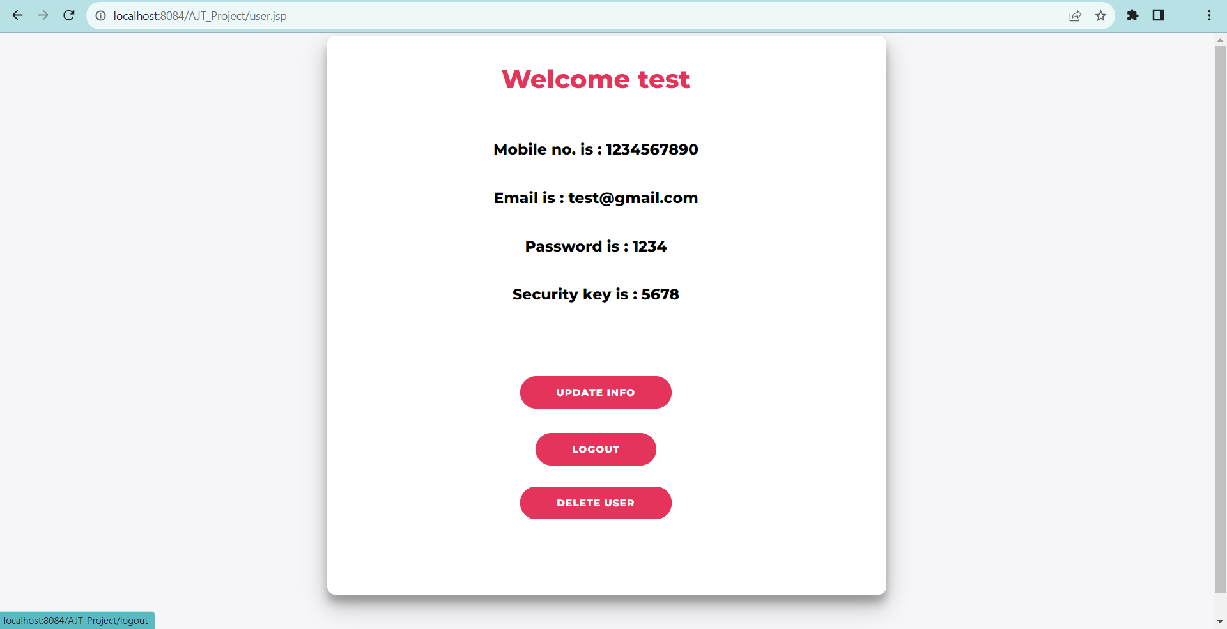
Now after login user will logout from website from profile section

Slide 28
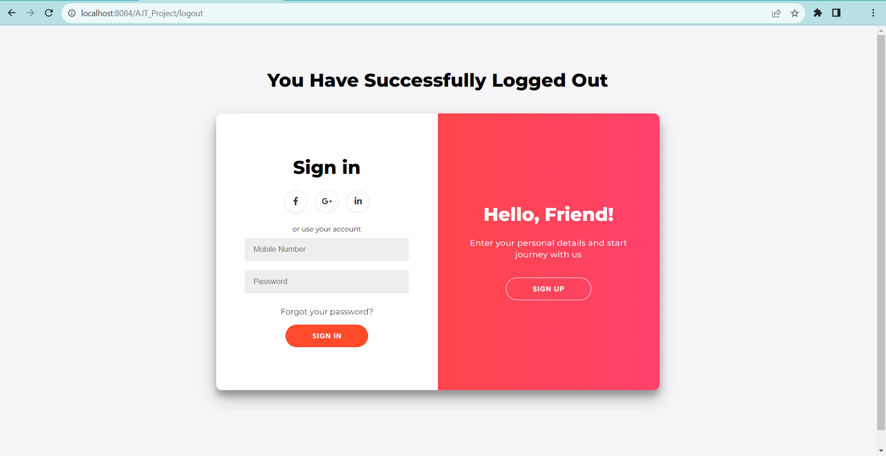
User has been successfully logged out

Slide 29
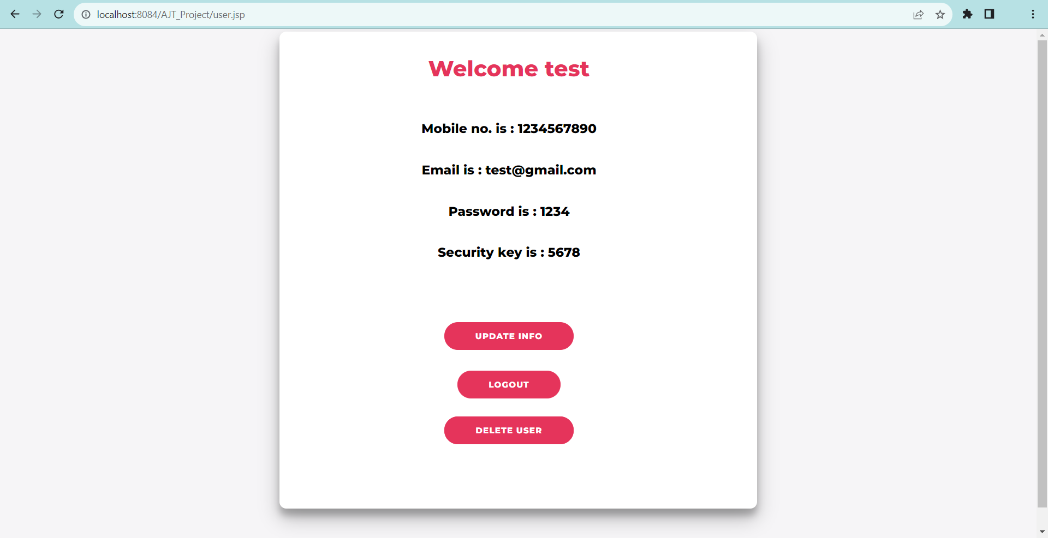
At last we will delete user account permanently.

Slide 30
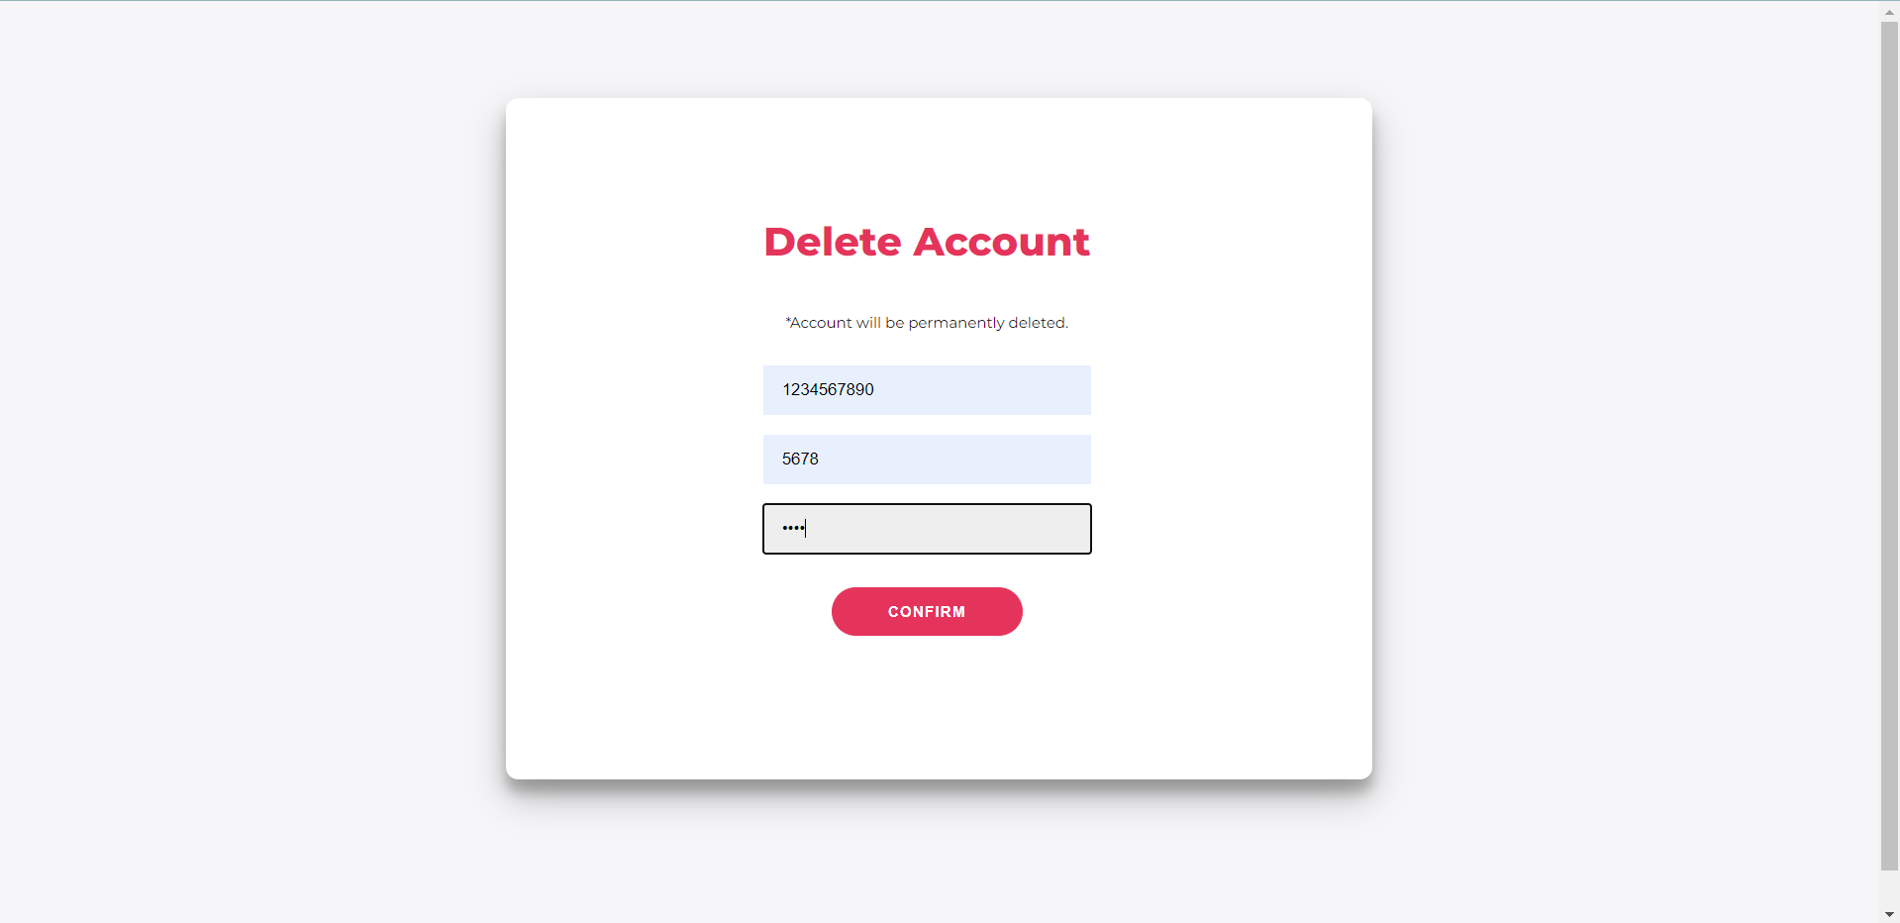
User will be permanently deleted

Slide 31
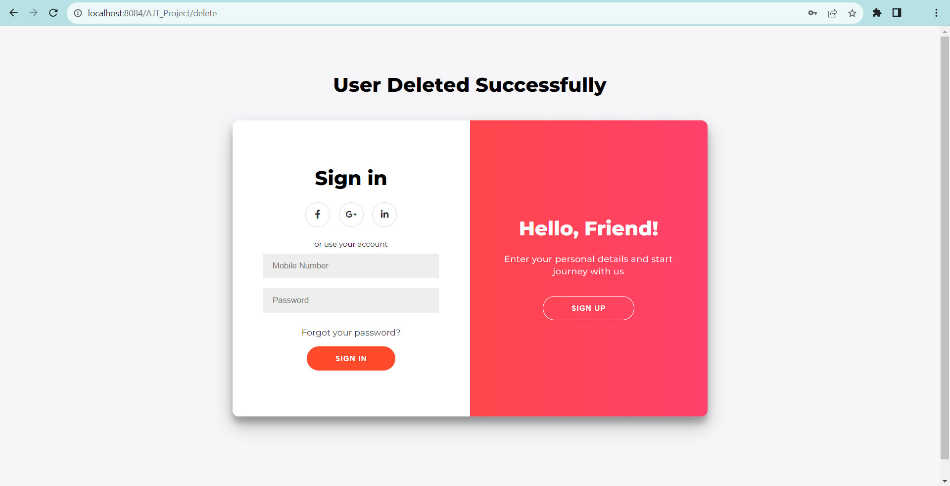
User Deleted Successfully

Slide 32
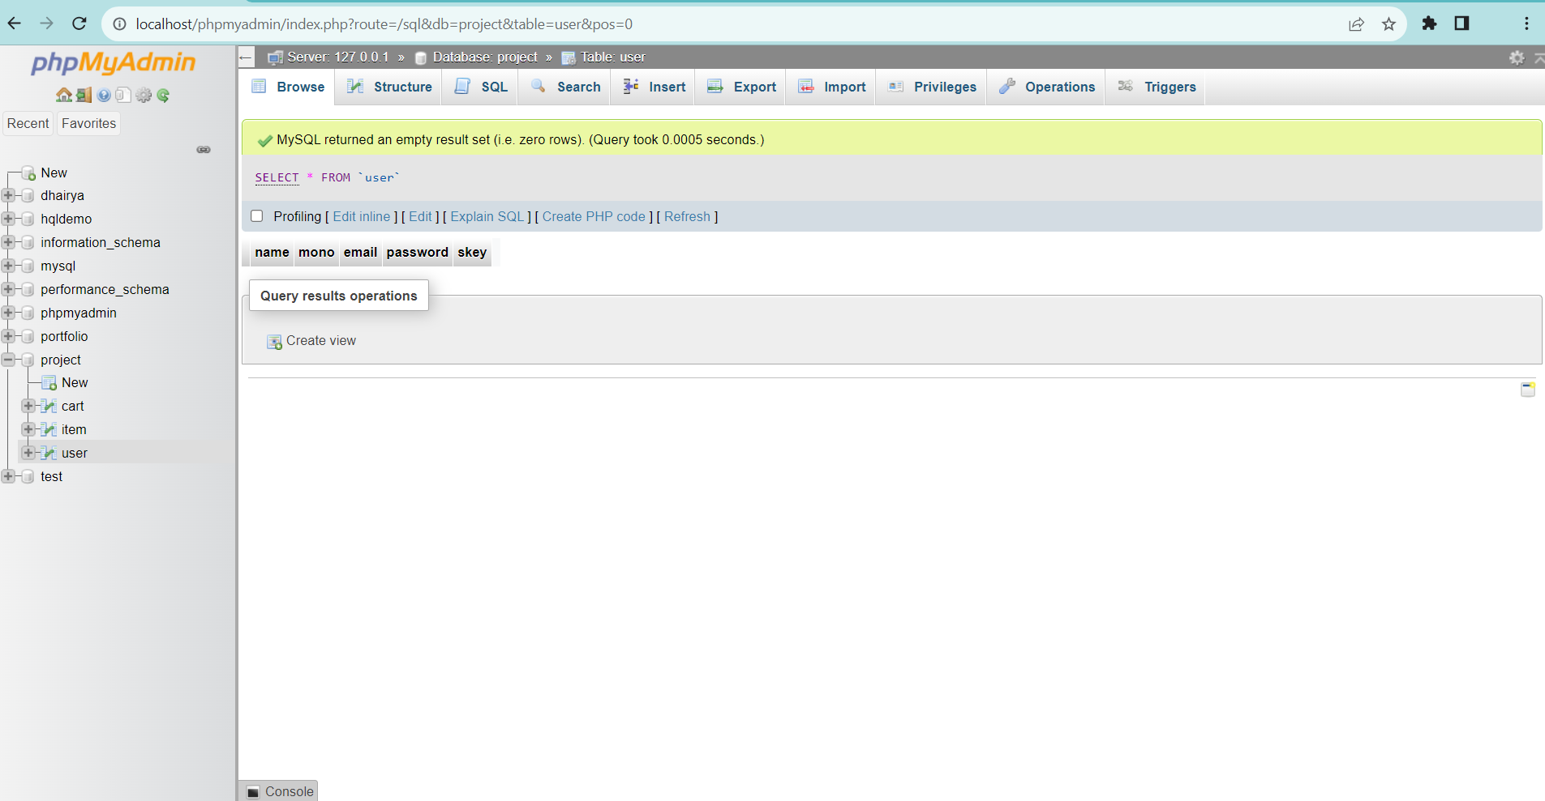
We can see in Database also user is deleted.

Slide 33
Conclusion
In this project, we have created a basic Ecommerce Shopping Website using Advanced Java. While it may not have all the features of Shopping Website, though it has helped us with valuable learning experiences.
Mainly we have implement crud operations in our project.

Slide 34
THANK YOU
By
Dhairya Aundhia 92200103268
Rishi Patel 92200103288

